Slide 1
Smart City Traffic Prediction using Machine Learning
Student name:

Slide 2
Introduction
In the realm of modern urban development, the concept of Smart Cities has emerged as a transformative force, promising enhanced sustainability, mobility, and quality of life. At the forefront of this urban evolution is the "Smart City Traffic Prediction" project, which seeks to address the critical challenge of managing traffic and congestion within urban environments. Leveraging advanced data analytics and predictive modeling, this initiative aims to create a cutting-edge Smart City Traffic Management .This system is designed to provide real-time traffic updates, congestion alerts, and optimized routes to commuters, offering an innovative solution for urban mobility. As the project unfolds, these insights will serve as a foundation for building a more efficient and sustainable urban future.

Slide 3
Problem Statement
The problem at hand revolves around the need to develop an advanced predictive model for the Smart City Traffic Prediction project. This model will harness data from Date Time and traffic volume , vehicle Count , Total Passing Vehicle Volume columns to forecast traffic patterns and congestion levels within a smart city. The primary challenge lies in accurately predicting traffic dynamics, enabling proactive resource allocation, optimized traffic flow, and congestion reduction at specific. By doing so, this initiative aims to contribute to more efficient urban planning, real-time traffic management, and informed decision-making, ultimately advancing the broader goal of transforming cities into smart, data-driven, and eco-friendly urban spaces.

Slide 4
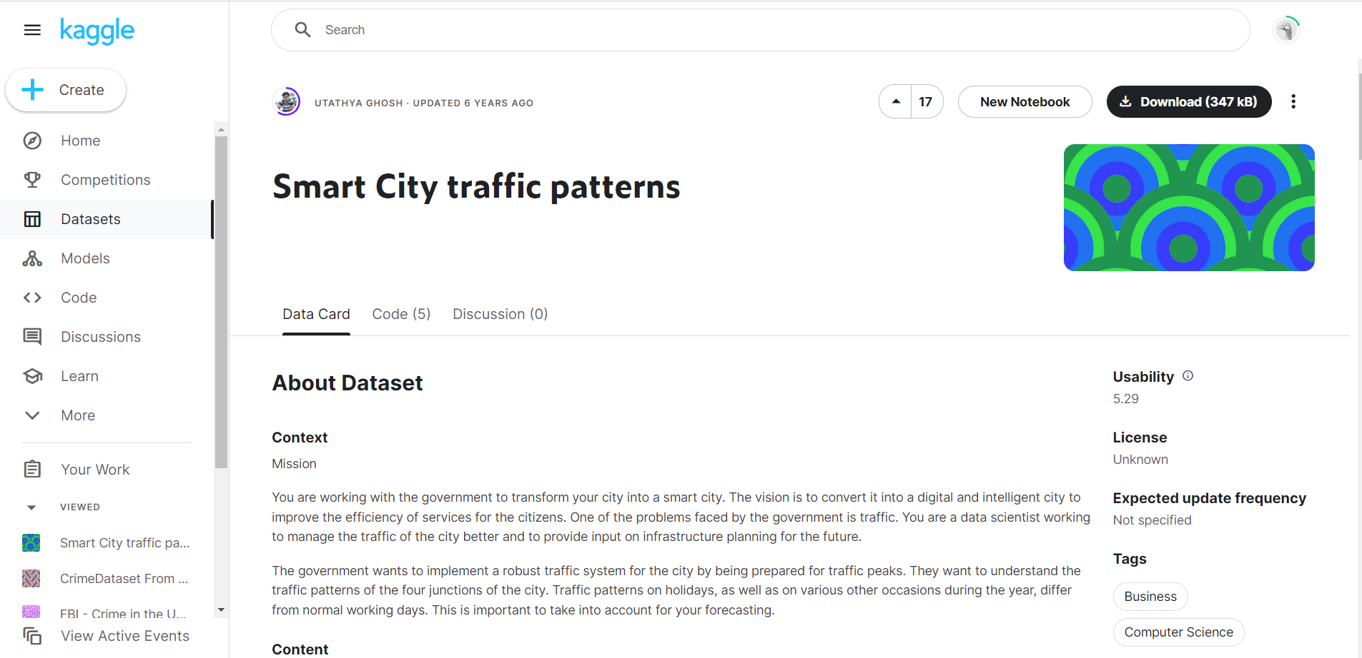
Dataset Description
DateTime: This column represents the date and time when a specific event or data point was recorded. The data type is typically a timestamp or datetime object. The values in this column represent the exact date and time, such as "2023-10-18 14:30:00."
Traffic Volume:
The traffic volume column contains information about the number of vehicles passing through a particular area or road. It likely represents the total count of vehicles passing during a given period, such as daily or hourly traffic.
Vehicle Count:
This column also represents the count of vehicles, potentially focusing on a specific type or category of vehicles. It could include various counts based on vehicle types, sizes, or classifications within the given traffic data.
Total Passing Vehicle Volume:
This column appears to represent a cumulative or aggregated value, possibly derived from the traffic volume and vehicle count columns.
It might be calculated as the product or sum of traffic volume and vehicle count, indicating the overall volume or total count of passing vehicles.

Slide 5
Motive
The motive behind the Smart City Traffic Prediction project can be summarized in four key points:
Enhancing Urban Mobility: To improve the daily commute experience for residents and visitors by providing real-time traffic information and alternate routes, reducing congestion, and saving time.
Sustainable Urban Development: Promoting eco-friendly urban planning by optimizing traffic flow, which in turn reduces fuel consumption and environmental impact, contributing to a more sustainable future.
Data-Driven Decision-Making: Leveraging advanced technologies and data analytics to empower city authorities and transportation companies with insights for informed decision-making in managing traffic and city resources.
Economic and Social Benefits: Creating safer and more livable cities not only enhances the quality of life for inhabitants but also stimulates economic growth and development through increased efficiency in transportation and urban services.

Slide 6
Market Research
Conducting comprehensive market research is essential for the successful implementation of the Smart City Traffic Management System project. The market research aims to understand the current landscape of smart city solutions, traffic management technologies, and the demand for data-driven urban mobility systems. This research will encompass an analysis of key stakeholders, including government agencies, urban planners, transportation companies, and technology providers. Furthermore, it will assess the competitive landscape to identify potential collaborators and competitors (Kothai et al., 2021).

Slide 7
Minimum Viable Product
The Minimum Viable Product (MVP) for the Smart City Traffic Management System is envisioned as a web-based dashboard that provides real-time traffic updates, predictive congestion alerts, and suggested alternate routes for commuters within the smart city. The MVP will initially focus on incorporating data from the Date Time and traffic volume , vehicle Count , Total Passing Vehicle Volume columns of the dataset. Users will be able to access this information through an intuitive and user-friendly interface. The MVP's core functionality includes data aggregation, analysis, and visualization, enabling commuters to make informed decisions to optimize their routes and reduce travel times.

Slide 8
Methodology
The methodology for the Smart City Traffic Prediction project comprises a multifaceted approach. It begins with comprehensive data collection from various sources, including sensors, traffic cameras, and historical datasets, which is followed by data cleansing, transformation, and integration to ensure accuracy. Subsequently, a predictive analytics engine, employing machine learning algorithms, is utilized to analyze this data and generate real-time traffic updates, congestion alerts, and suggested alternate routes. The user interface component encompasses web-based dashboards and mobile applications for end-users, facilitating access to these insights and enabling user customization for personalized recommendations. The project emphasizes iterative development, rigorous testing, and ongoing optimization to create a robust and effective Smart City Traffic Management System aligned with the objectives of enhancing urban mobility, sustainability, data-driven decision-making, and economic benefits (Dembski et al., 2020).

Slide 9
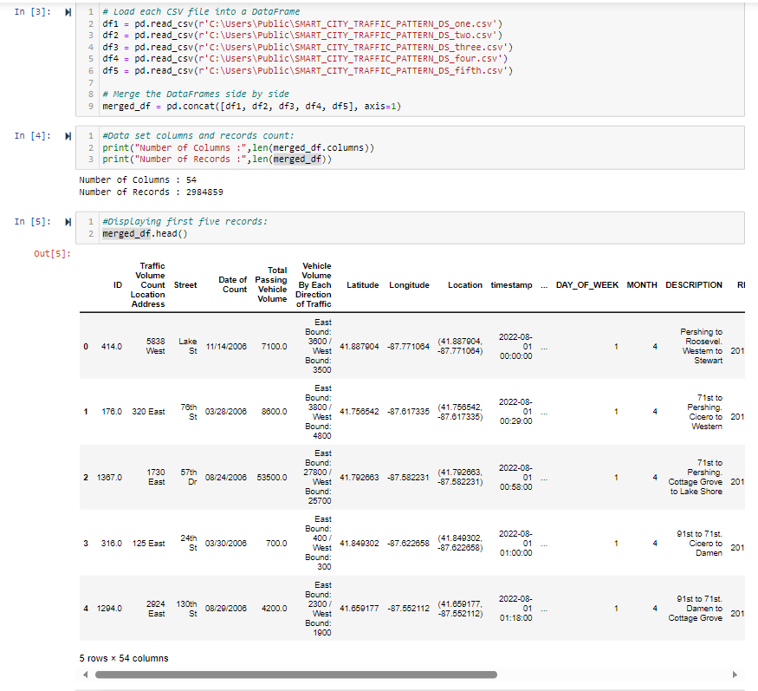
Data Set Information:

Slide 10
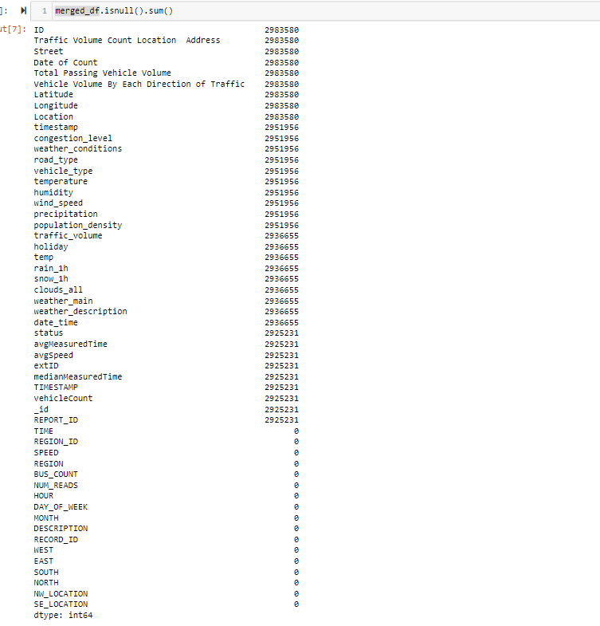
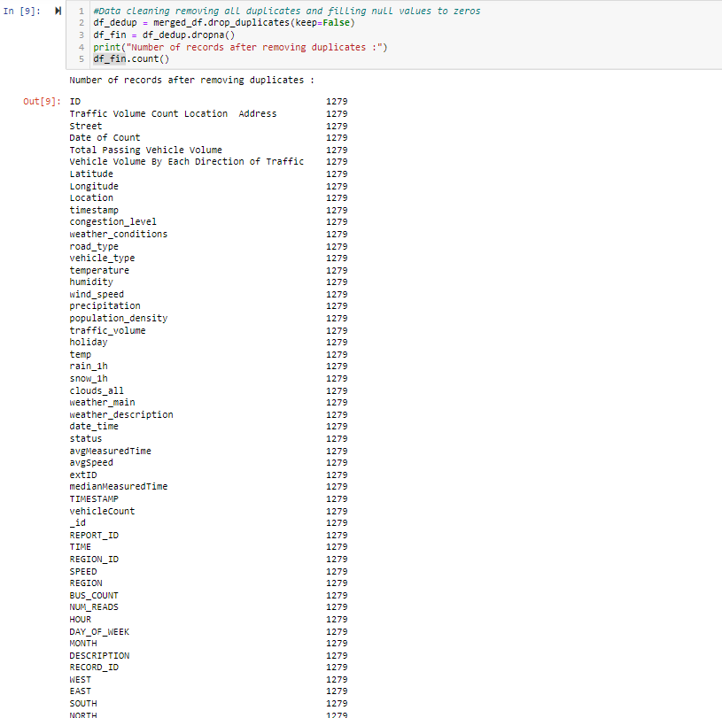
Data Cleaning

Slide 11
EDA Progress
Dataset Description: Detailed explanation of the dataset, including the 'DateTime,' Total Passing Vehicle Volume,' and 'ID' columns, and many more and their respective data types.
Count of Unique Values: Assessment of unique values in each column, indicating that has 2984859 records and has 54 columns.
EDA for weather_conditions: Visualization of data distribution across different weather conditions, demonstrating the balanced distribution of data points.
EDA for road_type: A reaffirming the even distribution of data points among the road type.
EDA for vehicle_type: Presentation of trends and patterns in vehicle type values over time, providing insights into the dataset's temporal dynamics.
EDA for weather_main : Visual summary of central tendency and variability in weather values, indicating consistent data distribution.
EDA for weather_description : Exploratory analysis using count plot to identify potential correlations or patterns.
EDA for MONTH: A graphical representation of the central tendency and variability in month readings, suggesting a consistent data distribution.
EDA for DAY_OF_WEEK: A visual representation of the central tendency and fluctuation in day of week readings, suggesting a consistent data distribution.
EDA for Year: Count plot is used in exploratory analysis to identify potential correlations or trends.

Slide 12
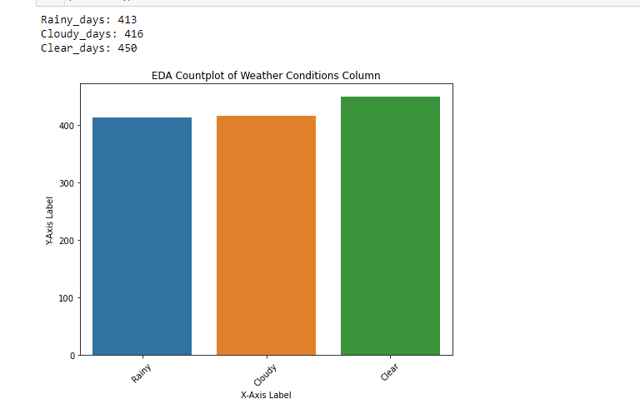
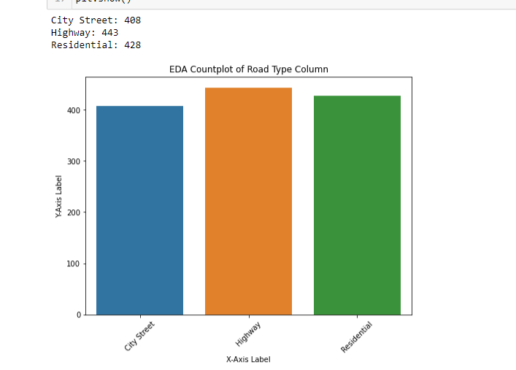
EDA Outcomes

Slide 13
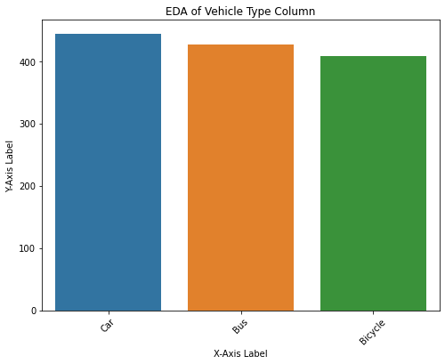
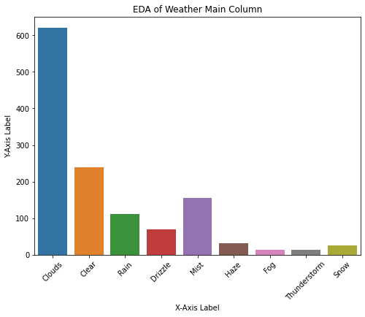
EDA Outcomes

Slide 14
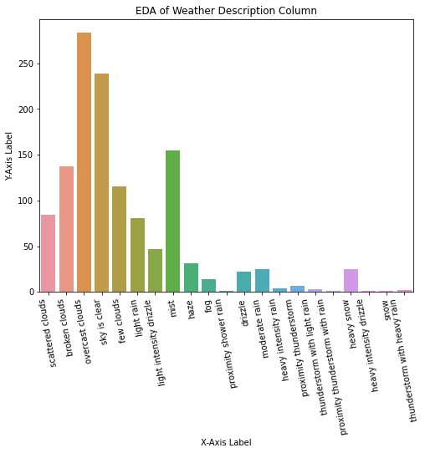
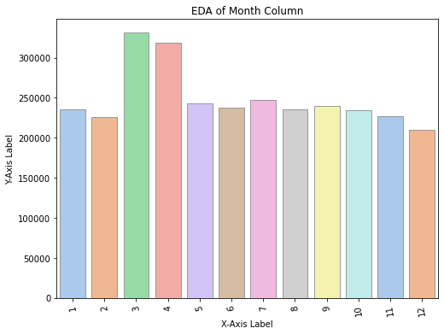
EDA Outcomes

Slide 15
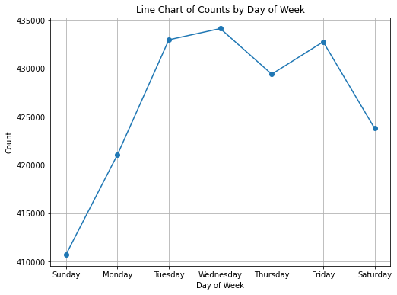
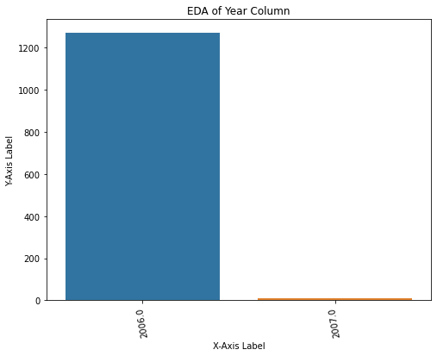
EDA Outcomes

Slide 16
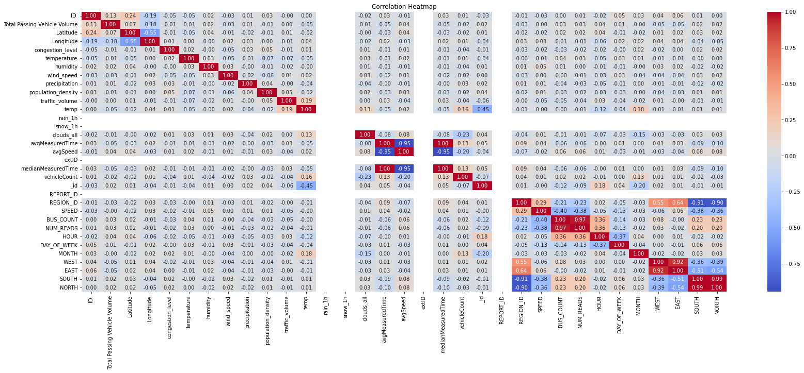
Heatmap of the correlation matrix

Slide 17
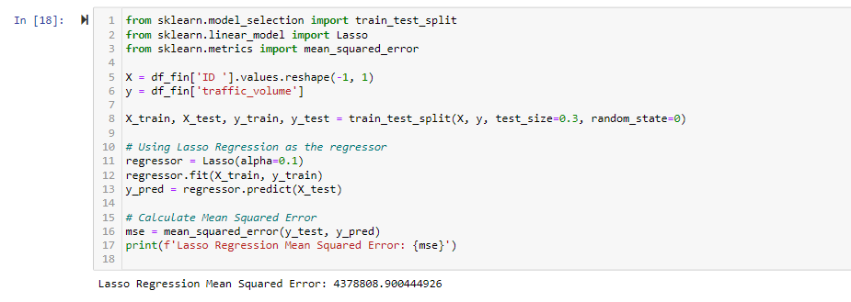
Lasso Regression On traffic_volume

Slide 18
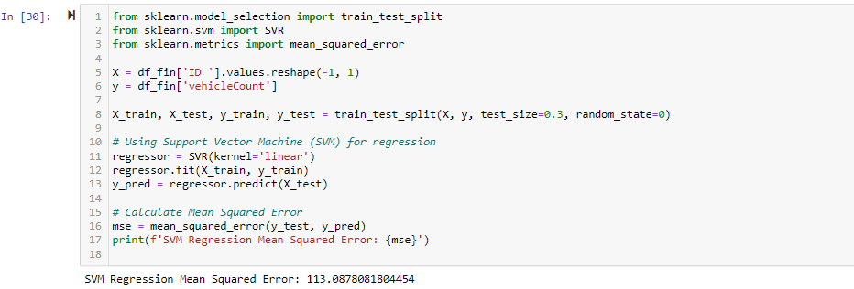
SVM Regression On vehicleCount

Slide 19
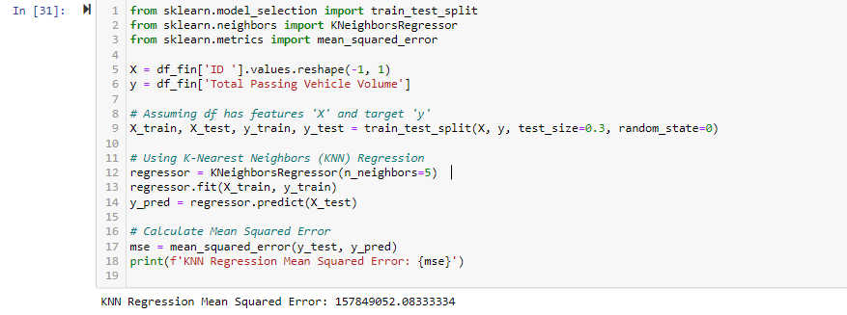
KNN Regression On Total Passing Vehicle Volume

Slide 20
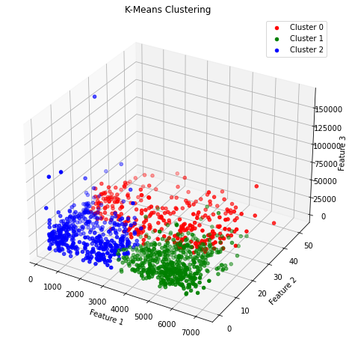
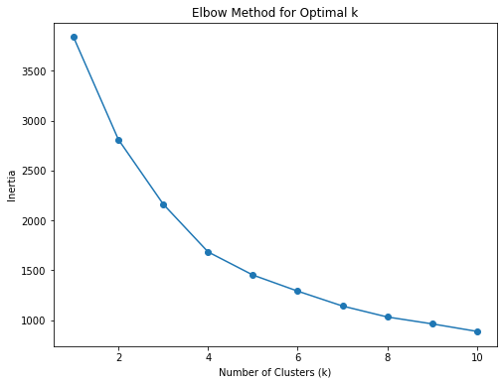
Clustering on traffic_volume, vehicleCount,Total Passing Vehicle Volume

Slide 21
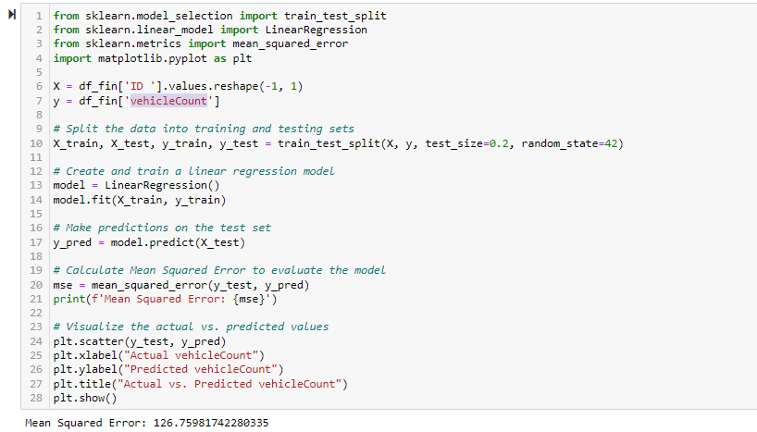
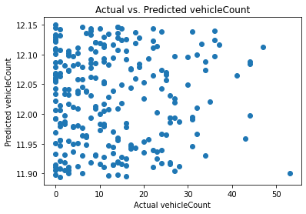
Linear regression model on vehicleCount

Slide 22
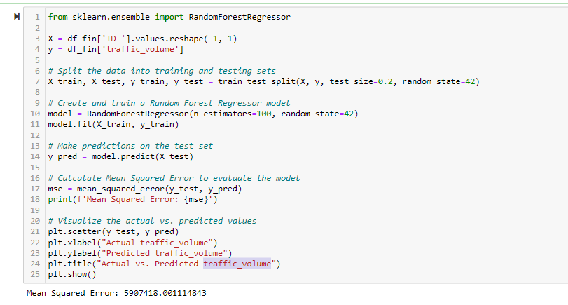
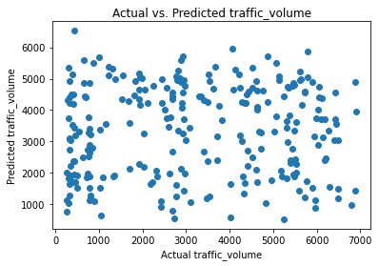
Random Forest Regressor model On traffic_volume

Slide 23
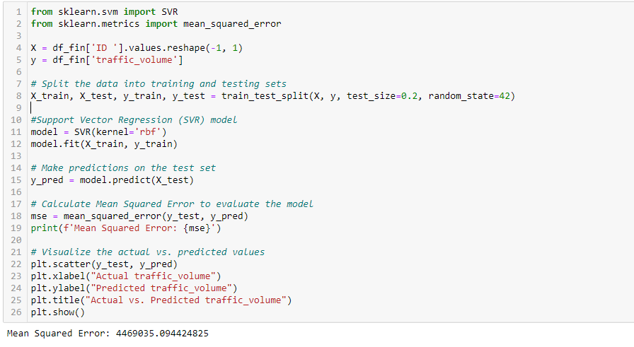
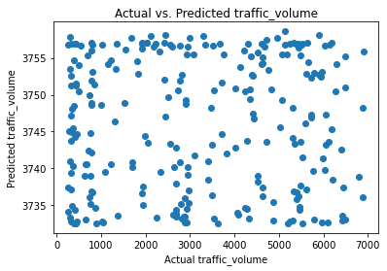
Support Vector Regression Model On Traffic Volume

Slide 24
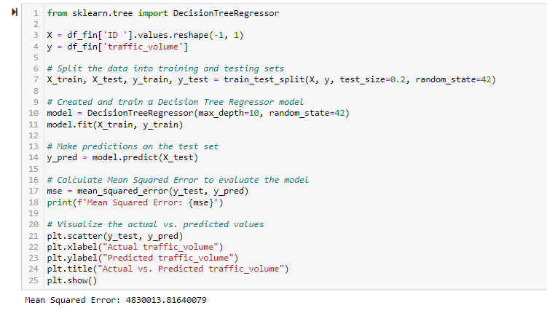
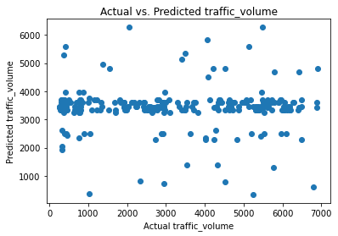
Decision Tree Regressor model on traffic_volume

Slide 25
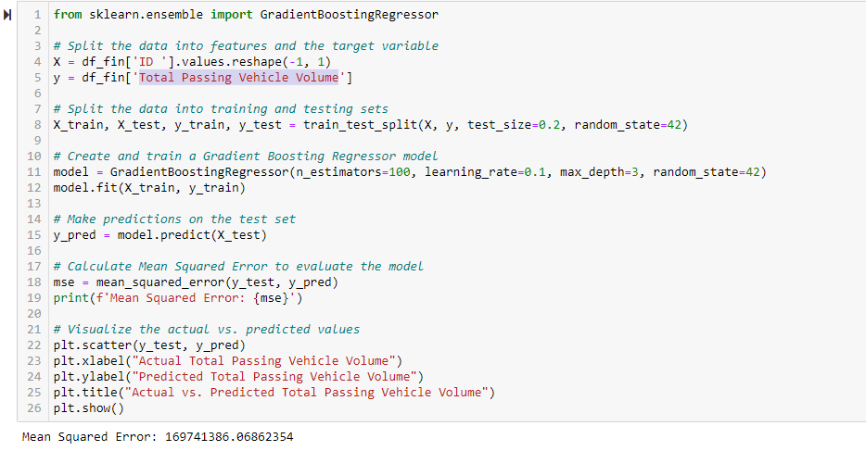
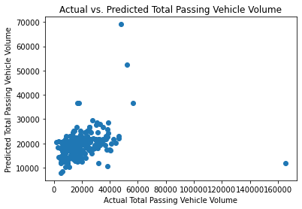
Gradient Boosting Regressor model On Total Passing Vehicle Volume

Slide 26
Key Findings
Based on the analysis of the dataset, several key findings can be observed. The time series plot for 'Date Time' allows us to track how the vehicle count values change over time, revealing any significant trends or recurring patterns. The absence of extreme outliers in the boxplot for traffic volume. Additionally, the 'ID' column contains unique values for each record, indicating that each 'ID' is distinct.

Slide 27
Conclusion
In conclusion, the exploratory data analysis (EDA) for the Smart City Traffic Prediction. The time series plot for 'DateTime' offers a glimpse into the temporal dynamics of traffic patterns. Additionally, the absence of extreme outliers in the boxplot indicates the relative consistency of data for each area. This EDA has laid a strong foundation for the project, offering a comprehensive overview of the dataset's attributes and enabling data-driven decision-making in the development of the Smart City Traffic Management System. As the project progresses, these insights will continue to inform the creation of a more efficient and sustainable urban future, aligned with the objectives of enhancing urban mobility, sustainability, data-driven decision-making, and economic benefits.

Slide 28
Reference
Kothai, G., Poovammal, E., Dhiman, G., Ramana, K., Sharma, A., AlZain, M. A., ... & Masud, M. (2021). A new hybrid deep learning algorithm for prediction of wide traffic congestion in smart cities. Wireless Communications and Mobile Computing, 2021, 1-13.
https://www.hindawi.com/journals/wcmc/2021/5583874/
Zhang, F., Wu, T. Y., Wang, Y., Xiong, R., Ding, G., Mei, P., & Liu, L. (2020). Application of quantum genetic optimization of LVQ neural network in smart city traffic network prediction. IEEE Access, 8, 104555-104564.
https://ieeexplore.ieee.org/abstract/document/9107118/

Slide 29
Thank You

